Slide 1

CS1010: Programming Methodology Lecture 11: Recursion

Slide 2
Week 11: Recursion
Objectives:
Understanding the nature of recursion.
Tracing recursive functions.
Writing recursive functions.
Comparing recursive codes with iterative codes.

Slide 3
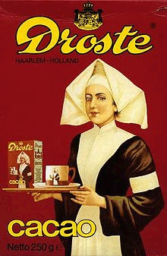
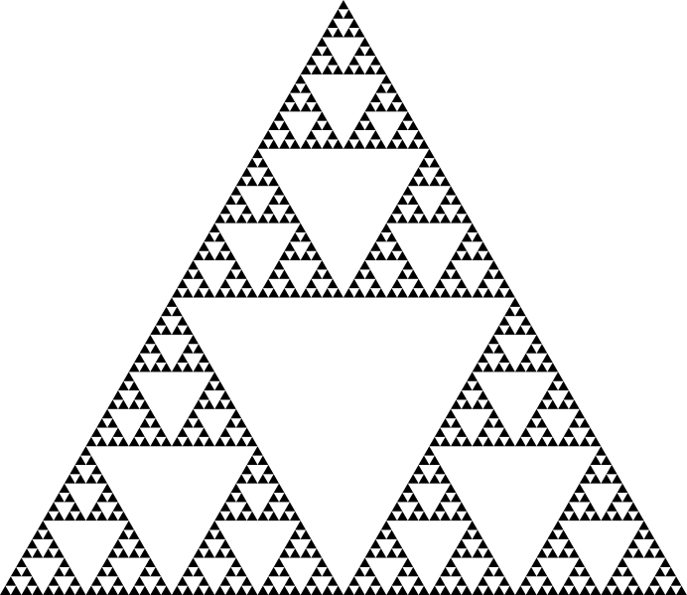
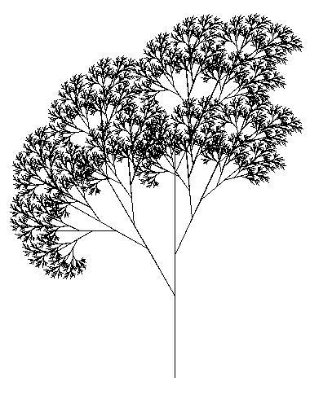
Non-CS Recursion Examples (1/4)
Sierpinksi triangle
Recursive tree
Droste effect
Notes:
Pictures from left to right.
A visual form of recursion known as the Droste Effect. The woman in this image is holding an object which contains a smaller image of her holding the same object, which in turn contains a smaller image of herself holding the same object, and so forth. From: http://en.wikipedia.org/wiki/Recursion
A Sierpinksi triangle —a confined recursion of triangles to form a geometric lattice. You can enlarge this to show more details to students. From: http://en.wikipedia.org/wiki/Recursion
Tree created using the Logo programming language and relying heavily on recursion. From: http://en.wikipedia.org/wiki/Recursion_(computer_science)

Slide 4
Non-CS Recursion Examples (2/4)
Dictionary entry:
Recursion: See recursion.
Recursive definitions:
A person is a descendant of another if
the former is the latter’s child, or
the former is one of the descendants of the latter’s child.
A list of numbers is
a number, or
a number followed by a list of numbers.
To understand recursion, you must first understand recursion.

Slide 5
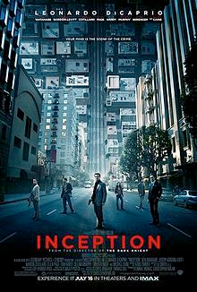
Non-CS Recursion Examples (3/4)
void dream(int level) {
printf(“dream level %d\n”, level);
if (level == 3)
wakeup(level);
else
{
dream(level+1);
wakeup(level);
}
}
void wakeup(int level) {
printf(“waking up at level %d\n”, level);
}
dream level 1
dream level 2
dream level 3
waking up at level 3
waking up at level 2
waking up at level 1
Full story: http://repeatgeek.com/technical/how-to-view-inception-through-code/

Slide 6
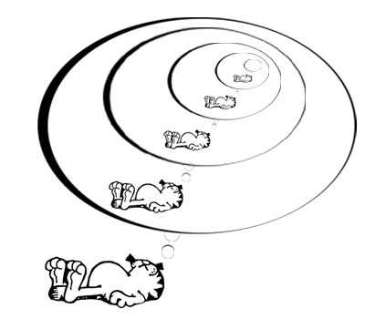
Non-CS Recursion Examples (4/4)
Recursive dreaming, zzz…
Notes:
Garfield dreams recursively.

Slide 7
Write Recursive Program (1/2)
There is NO new syntax needed for recursion.
Recursion is a form of (algorithm) design; it is a problem-solving technique for divide-and-conquer paradigm.
A very important paradigm – many CS problems solved using it.
Recursion is:
A method where the solution to a problem depends on solutions to smaller instances of the same problem.
Notes:
Recursion is not a new syntax, it is a new thinking
Reference of quote: Graham, Ronald; Donald Knuth, Oren Patashnik (1990). Concrete Mathematics. Chapter 1: recurrence Problems. http://www-cs-faculty.stanford.edu/~knuth/gkp.html

Slide 8
Write Recursive Program (2/2)
General idea of recursive algorithms:
Winding phase
Invoking/calling ‘itself’ to solve smaller or simpler instance(s) of a problem …
… and then building up the answer(s) of the simpler instance(s).
Unwinding phase

Slide 9
Demo #1: Factorial (1/3)
n! = n × (n – 1) × (n – 2) × … × 2 × 1
Iterative code (Ver. 1)
// Pre-cond: n >= 0
int factorial_iter1(int n)
{
int ans = 1, i;
for (i=1; i<=n; i++) {
ans *= i;
}
return ans;
}
Iterative code (Ver. 2)
// Pre-cond: n >= 0
int factorial_iter2(int n)
{
int ans = 1;
while (n >= 1) {
ans *= n;
n--;
}
return ans;
}

Slide 10
Demo #1: Factorial (2/3)
n! = n × (n – 1) × (n – 2) × … × 2 × 1
recurrence relation:
n! = n × (n – 1)!
0! = 1
Doing it in a recursive way?
// Pre-cond: n >= 0
int factorial(int n)
{
if (n == 0) // base case
return 1;
else
return n * factorial(n-1);
}
No loop structure at all!
But calling function itself (recursively) brings out repetition.
Side note: all the three versions work only for n < 13, due to the range of values permissible by data type int. This is the limitation of the data type, not a limitation of the problem-solving model.

Slide 11
Demo #1: Factorial (3/3)
int f(int n) {
if (n == 0) // base case
return 1;
else
return n * f(n-1);
}
Trace factorial(3)
* for simplicity, we write f(3)
Winding:
f(3): Since 3 ≠ 0, call 3 * f(2)
f(2): Since 2 ≠ 0, call 2 * f(1)
f(1): Since 1 ≠ 0, call 1 * f(0)
f(0): Since 0 == 0, …
Trace tree:
f(3)
6
Unwinding:
3 *
f(2)
2
f(0): Return 1
f(1): Return 1 * f(0) = 1 * 1 = 1
f(2): Return 2 * f(1) = 2 * 1 = 2
f(3): Return 3 * f(2) = 3 * 2 = 6
2 *
f(1)
1
1 *
f(0)
1

Slide 12

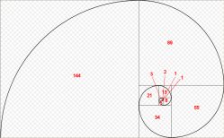
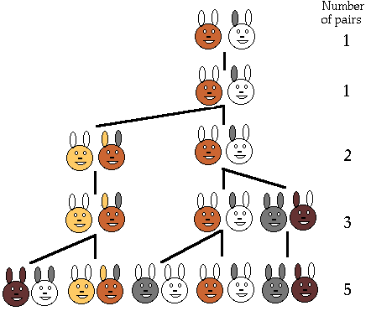
Demo #2: Fibonacci (1/3)
The Fibonacci series models the rabbit population each time they mate:
1, 1, 2, 3, 5, 8, 13, 21, …
The modern version is:
0, 1, 1, 2, 3, 5, 8, 13, 21, …
Fibonacci numbers are found in nature (sea-shells, sunflowers, etc.)
http://www.maths.surrey.ac.uk/hosted-sites/R.Knott/Fibonacci/fibnat.html
Notes:
Population growth is related to the Fibonacci series. It was the question of how fast rabbits could breed under ideal circumstances that Leonardo Fibonacci originally investigated in the year 1202. Here was the question he posed:
Suppose a newborn pair of rabbits, one male and one female, is put in the wild. The rabbits mate at the age of one month and at the end of its second month a female can produce another pair of rabbits. Suppose that the rabbits never die and that each female always produces one new pair, with one male and one female, every month from the second month on. How many pairs will there be in one year?
The sequence is 1 1 2 3 5 8 13 21 ….

Slide 13
Demo #2: Fibonacci (2/3)
0, 1, 1, 2, 3, 5, 8, 13, 21, …
Iterative version:
Recursive version:
// Pre-cond: n >= 0
int fib_iter(int n)
{
int prev1 = 1, prev2 = 0,
current;
if (n < 2)
return n;
for (; n>1; n--) {
current = prev1 + prev2;
prev2 = prev1;
prev1 = current;
}
return current;
}
// Pre-cond: n >= 0
int fib(int n)
{
if (n < 2) // base case
return n;
else
return fib(n-1) + fib(n-2);
}
recurrence relation:
f_{n} = f_{n-1} + f_{n-2} n ≥ 2
f₀ = 0
f₁ = 1

Slide 14
Fibonacci (3/3)
int fib(int n) {
if (n < 2) // base case
return n;
else
return fib(n-1) + fib(n-2);
}
fib(n) makes 2 recursive calls: fib(n-1) and fib(n-2)
Trace tree (or call tree) for fib(5):
Winding
5
Unwinding
fib(5)
3
2
fib(4)
fib(3)
2
1
1
1
fib(3)
fib(2)
fib(2)
fib(1)
1
1
1
0
1
0
fib(2)
fib(1)
fib(1)
fib(0)
fib(1)
fib(0)
1
0
fib(1)
fib(0)
Notes:
We need to finish the first function call first before we can make the second function call.
The same computations are done over and over again!

Slide 15
Exercises #1
Given the following 2 recursive functions, trace mystery1(3902) and mystery2(3902) using the trace tree method.
void mystery1(int n)
{
if (n > 0)
{
printf("%d", n%10);
mystery1(n/10);
}
}
void mystery2(int n)
{
if (n > 0)
{
mystery2(n/10);
printf("%d", n%10);
}
}
The order of statements does matter!

Slide 16


Gist of Recursion (1/6)
Iteration vs. Recursion: How to compute factorial(3)?
You, do f(2) for me. I’ll return 3 * your answer to my boss.
Recursion man
You, do f(1) for me. I’ll return 2 * your answer to my boss.
Iteration man
I do f(3) all by myself…return 6 to my boss.
f(3)
You, do f(0) for me. I’ll return 1 * your answer to my boss.
f(2)
I will do f(0) all by myself, and return 1 to my boss.
f(3)
f(1)
f(0)
Notes:
Only the winding phase is shown for “recursion man”. Unwinding phase is too complex to animate.

Slide 17
Gist of Recursion (2/6)
Recursion man
I do f(3) all by myself…return 6 to my boss.
You, do f(2) for me. I’ll return 3 * your answer to my boss.
You, do f(1) for me. I’ll return 2 * your answer to my boss.
Iteration man
You, do f(0) for me. I’ll return 1 * your answer to my boss.
f(3)
f(3)
f(2)
f(1)
Iterative version:
Recursive version:
// Pre-cond: n >= 0
int factorial_iter1(int n)
{
int ans = 1, i;
for (i=1; i<=n; i++) {
ans *= i;
}
return ans;
}
// Pre-cond: n >= 0
int factorial(int n)
{
if (n == 0) // base case
return 1;
else
return n * factorial(n-1);
}

Slide 18
Gist of Recursion (3/6)
Problems that lead themselves to a recursive solution have the following characteristics:
One or more simple cases (also called base cases or anchor cases) of the problem have a straightforward, non-recursive solution.
The other cases can be redefined in terms of problems that are smaller, i.e., closer to the simple cases.
By applying this redefinition process every time the recursive function is called, eventually the problem is reduced entirely to simple cases, which are relatively easy to solve.
The solutions of the smaller problems are combined to obtain the solution of the original problem.

Slide 19
Gist of Recursion (4/6)
To write a recursive function:
Identify the base case(s) of the relation
Identify the recurrence relation
// Pre-cond: n >= 0
int factorial(int n)
{
if (n == 0)
return 1;
else
return n * factorial(n-1);
}
// Pre-cond: n >= 0
int fib(int n)
{
if (n < 2)
return n;
else
return fib(n-1) + fib(n-2);
}

Slide 20
Gist of Recursion (5/6)
When a function is called, an activation record (frame) is created by the system.
Each activation record stores the local parameters and variables of the function and its return address.
Each record resides in the memory called stack.
Stack is also known as LIFO (last-in-first-out) structure.
A recursive function can potentially create many activation records.
Winding: each recursive call creates a separate record.
Unwinding: each return to the caller erases its associated record.

Slide 21
Gist of Recursion (6/6)
int f(int n) {
if (n == 0)
return 1;
else
return n * f(n-1);
}
Example: factorial(3)
n
0
Stack
1
n
n
n
1
1
1
n
n
n
n
1
2
2
2
2
n
n
n
n
n
3
3
3
3
3
f(3)
f(2)
f(1)
f(0)
n
2
n
n
2
3
3
6
Notes:
Stack is a memory area that system used to trace function calls.

Slide 22

Thinking Recursively
It is apparent that to do recursion you need to think “recursively”:
Breaking a problem into simpler problems that have identical form.

Slide 23
Think: Sum of Squares (1/5)
Given 2 positive integers x and y, where x ≤ y, compute
sumSq(x,y) = x² + (x+1) ² + … + (y-1) ² + y²
For example
sumSq(5,10) = 5² + 6² + 7² + 8² + 9² + 10² = 355
How will you break this problem into smaller problems?
How many ways can it be done?
We are going to show 3 versions

Slide 24
Think: Sum of Squares (2/5)
Version 1: ‘going up’
355
sumSq1(5,10)
int sumSq1(int x, int y)
{
if (x == y)
return x*x;
else
return x*x + sumSq1(x+1, y);
}
25
+
330
sumSq1(6,10)
36
+
294
sumSq1(7,10)
49
+
245
sumSq1(8,10)
64
+
181
sumSq1(9,10)
81
+
100
sumSq1(10,10)
100

Slide 25
Think: Sum of Squares (3/5)
Version 2: ‘going down’
355
sumSq2(5,10)
int sumSq2(int x, int y)
{
if (x == y)
return y*y;
else
return y*y + sumSq2(x, y-1);
}
100
+
255
sumSq2(5,9)
81
+
174
sumSq2(5,8)
64
+
110
sumSq2(5,7)
49
+
61
sumSq2(5,6)
36
+
25
sumSq2(5,5)
25

Slide 26
Think: Sum of Squares (4/5)
Version 3: ‘combining two half-solutions’
int sumSq3(int x, int y)
{
int mid; // middle value
if (x == y) // base case
return x*x;
else
{
mid = (x + y)/2;
return sumSq3(x, mid) + sumSq3(mid+1, y);
}
}

Slide 27
Think: Sum of Squares (5/5)
int sumSq3(int x, int y)
{
...
return sumSq3(x, mid) +
sumSq3(mid+1, y);
}
Version 3 trace tree
355
sumSq3(5,10)
110
245
sumSq3(5,7)
sumSq3(8,10)
61
49
145
100
sumSq3(5,6)
sumSq3(7,7)
sumSq3(8,9)
sumSq3(10,10)
25
36
49
64
81
100
sumSq3(5,5)
sumSq3(6,6)
sumSq3(8,8)
sumSq3(9,9)
25
36
64
81

Slide 28
Exercises #2
The recurrence relation for Greatest Common Divisor (GCD) of two non-negative integers a and b, not both zero, is given below:
Write a recursive function int gcd(int a, int b) to compute the GCD of a and b.
Skeleton:
Sample runs:
cp ~cs1010/lecture/Week11_gcd.c .
Enter two integers: 4 7
gcd(4, 7) = 1
Enter two integers: 4 16
gcd(4, 16) = 4

Slide 29
Demo #3: Sum Array (1/4)
Given an array
int arr[] = { 9, -2, 1, 7, 3, 9, -5, 7, 2, 1, 7, -2, 0, 8, -3 }
We want the function call
sumArray(arr, 15)
to return the sum of elements in this array.

Slide 30
Demo #3: Sum Array (2/4)
Iterative version:
int sumArray_itr(int arr[], int size)
{
int sum=0, i;
for (i=0; i<size; i++)
sum += arr[i];
return sum;
}
Week11_SumArray.c

Slide 31
Demo #3: Sum Array (3/4)
To get sumArray(list, 15) to return sum of array, recursive thinking goes…
9
-2
1
7
3
9
-5
7
2
1
7
-2
0
8
-3
… and get someone to compute the sum for this smaller problem, …
If I handle the last element myself, …
… then my answer is just his answer plus the value of last element!

Slide 32
Demo #3: Sum Array (4/4)
[0]
[1]
[2]
[3]
[4]
[5]
[6]
[7]
[8]
[9]
[10]
[11]
[12]
[13]
[14]
9
-2
1
7
3
9
-5
7
2
1
7
-2
0
8
-3
Recursive version:
Week11_SumArray.c
int sumArray(int arr[], int size) {
if (size == 1)
return arr[size-1];
else
return arr[size-1] + sumArray(arr, size-1);
}
sumArray(arr, 15)
-3 +
sumArray(arr, 14)
0 +
sumArray(arr, 12)
...
8 +
sumArray(arr, 13)

Slide 33
Auxiliary Function (1/3)
Sometimes, auxiliary functions are needed to implement recursion.
For Demo #3 Sum Array.
If the function handles the first element instead of the last, it would be re-written as follows:
9
-2
1
7
3
9
-5
7
2
1
7
-2
0
8
-3
int sumArray(int arr[], int start, int size)
{
if (start == size-1)
return arr[start];
else
return arr[start] + sumArray(arr, start+1, size);
}

Slide 34
Auxiliary Function (2/3)
However, doing so means that the calling function has to change the call from:
sumArray(arr, size)
to
sumArray(arr, 0, size)
The additional parameter 0 seems like a redundant data from the point of view of caller (e.g., your teammate).
int sumArray(int arr[], int start, int size)
{
if (start == size-1)
return arr[start];
else
return arr[start] + sumArray(arr, start+1, size);
}

Slide 35
Auxiliary Function (3/3)
Improvement: let the caller (e.g., your teammate), in his comfort, still call:
sumArray(arr, size)
Then you write the following two functions:
Auxiliary
function
int sumArray(int arr[], int size) {
return sumArray_rec(arr, 0, size);
}
recursive
function
int sumArray_rec(int arr[], int start, int size) {
if (start == size-1)
return arr[start];
else
return arr[start] + sumArray_rec(arr, start+1, size);
}

Slide 36
Demo #4: Counting Occurrences (1/4)
Self-read
Given an array
int list[] = { 9, -2, 1, 7, 3, 9, -5, 7, 2, 1, 7, -2, 0, 7, -3 }
We want the function call
countValue(7, list, 15)
to return 3 (the number of times 7 appears in the 15 elements of list).

Slide 37
Demo #4: Counting Occurrences (2/4)
Self-read
Iterative version:
int countValue_iter(int value, int arr[], int size) {
int count = 0, i;
for (i=0; i<size; i++)
if (value == arr[i])
count++;
return count;
}
Week11_countValue.c

Slide 38
Demo #4: Counting Occurrences (3/4)
Self-read
To get countValue(7, list, 15) to return 3.
Recursive thinking goes…
9
-2
1
7
3
9
-5
7
2
1
7
-2
0
7
-3
… and get someone to count 7 in this smaller problem, …
If I handle the last element myself, …
… then, depending on whether the last element is 7 or not, my answer is either his answer or his answer plus 1!

Slide 39
Demo #4: Counting Occurrences (4/4)
Self-read
[0]
[1]
[2]
[3]
[4]
[5]
[6]
[7]
[8]
[9]
[10]
[11]
[12]
[13]
[14]
9
-2
1
7
3
9
-5
7
2
1
7
-2
0
7
-3
Recursive version:
int countValue(int value, int arr[], int size) {
if (size == 1)
return value == arr[0];
else
return (value == arr[size-1]) +
countValue(value, arr, size-1);
}
Week11_countValue.c
countValues(7, arr, 15)
0 +
countValues(7, arr, 14)
0 +
countValues(7, arr, 12)
...
1 +
countValues(7, arr, 13)

Slide 40
Tracing Recursive Codes
Beginners usually rely on tracing to understand the sequence of recursive calls and the passing back of results.
However, tracing a recursive code is tedious and the trace tree could be huge (example: Fibonacci series).
If you find that tracing is needed to aid your understanding, start tracing with small problem sizes, then gradually see the relationship between the successive calls.
Students should grow out of tracing habit and understand recursion by examining the relationship between the problem and its immediate sub-problem(s).

Slide 41
Recursion versus Iteration (1/2)
Iteration can be more efficient
Replaces function calls with looping
Less memory is used (no activation record for each call)
Some good compilers are able to transform a (tail-) recursion code into an iterative code.
If a problem can be done easily with iteration, then do it with iteration.
For example, Fibonacci series can be coded with iteration or recursion, but the recursive version is very inefficient (large call tree due to duplicate computations), so use iteration instead.

Slide 42
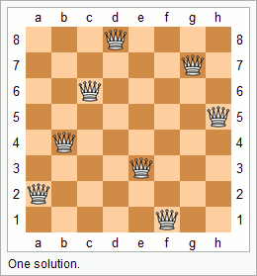
Recursion versus Iteration (2/2)
Many problems are more naturally solved with recursion, which can provide elegant solution.
Towers of Hanoi (self-reading slides)
Mergesort (covered in CS1020)
The N Queens problem (mentioned in CS1020)
Conclusion: choice depends on problem and the solution context. In general, use recursion if
A recursive solution is natural and easy to understand.
A recursive solution does not result in excessive duplicate computation.
The equivalent iterative solution is too complex.

Slide 43

Summary for Today
Today’s most important lessons
Recursion as a design methodology
The components of a recursive code
Difference between Recursion and Iteration

Slide 44
End of File

